Slide 1
Oso, Washington Landslide
Brigham Young University CEEN 544
William Garner and Noah Taylor

Slide 2
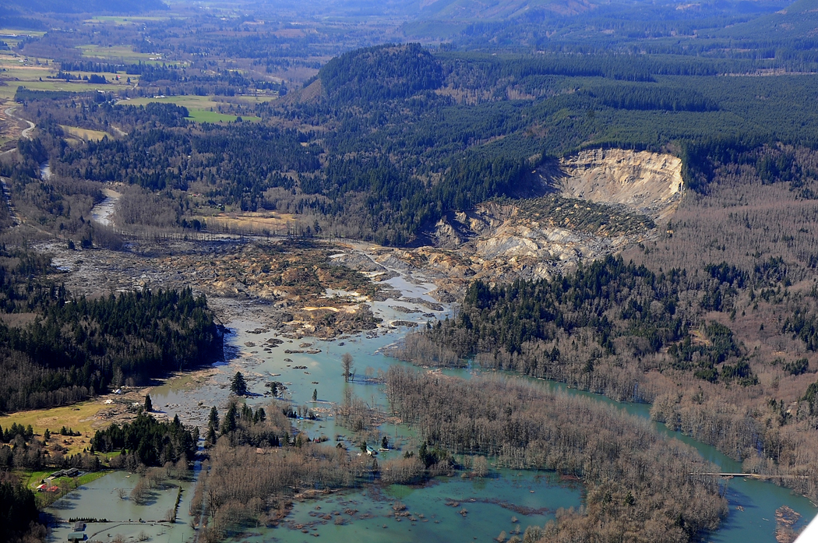
History
March 22, 2014
10 million cubic yards of soil
30 homes destroyed
43 fatalities
High Mobility. Moved .7 miles (MARK REID, USGS)
Second Largest Deadliest earthquake in (USGS 2014)

Slide 3
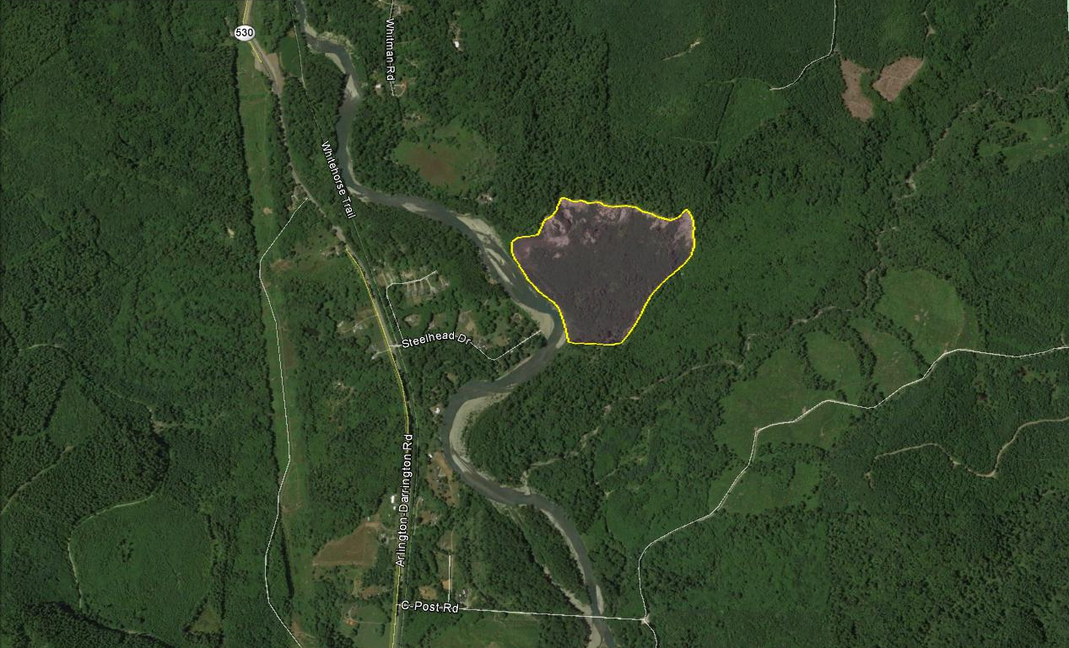
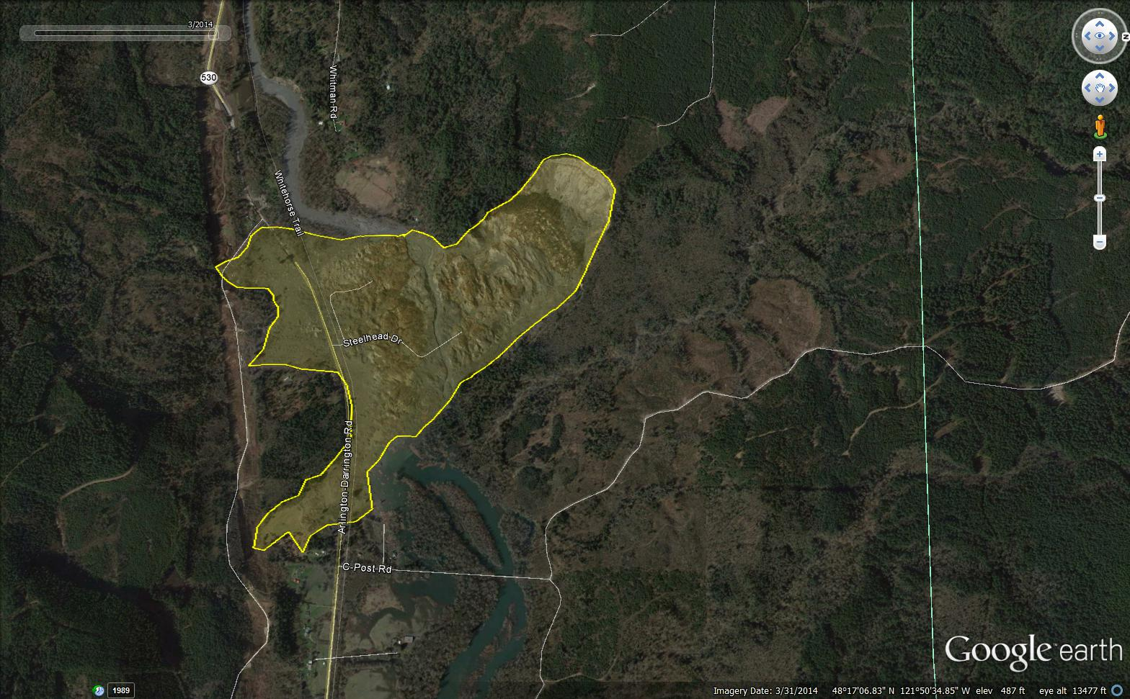
Before (07/2013)|After (03/2014)

Slide 4
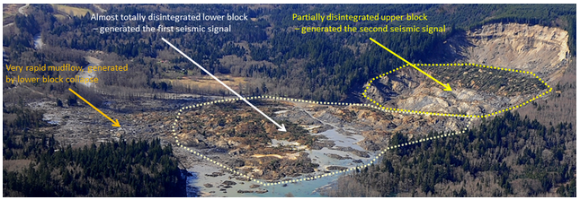
Sequence of Events
Notes:
The landslide occurred in two stages. First, a lower segment of the slope gave way. Followed by progressive failures of the upper slope. As the upper block gave way it produced large compressional forces causing an undrained loading condition for the lower block and subsequently cause static liquefaction. This led to the rapid mobility of mudflows at the base of the landslide.

Slide 5
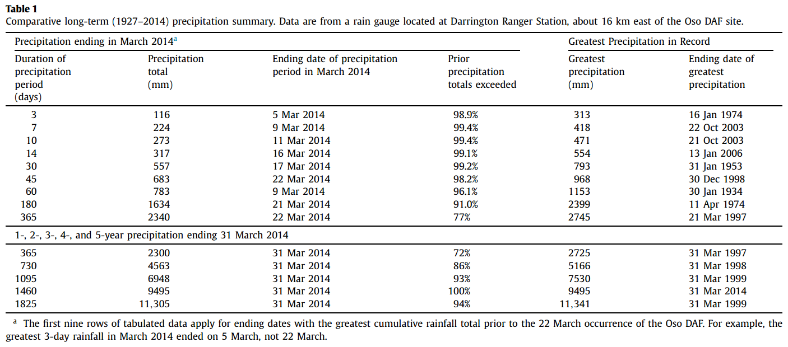
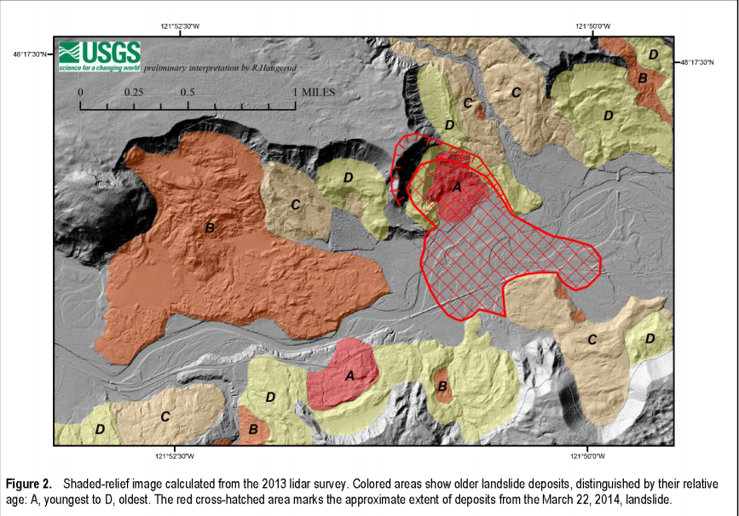
Geologic and Meteorologic Setting
Notes:
Occurred after a long period of unusually high amount of precipitation. The basic geology consisted of glacial till with a base of glaciolacustrine silt-and-clay. This type of geology historically has been prone to landslides in the past (Keaton et al, 2014)

Slide 6
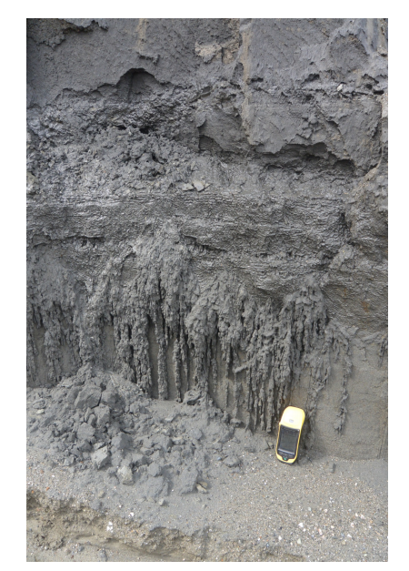
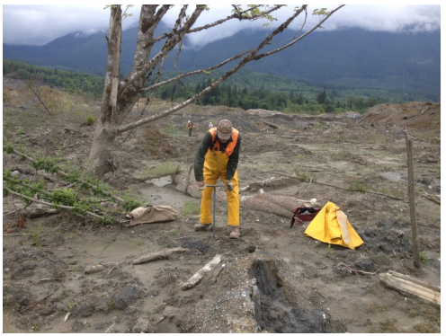
Data Acquisition
Observational Data
Hand Auger used to collect soil samples
18 Seismic Station
Lidar
Eye Witness Statements

Slide 7
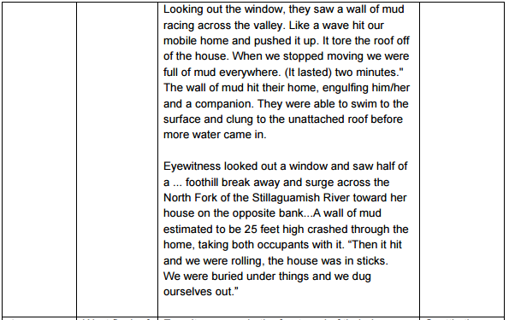

Slide 8
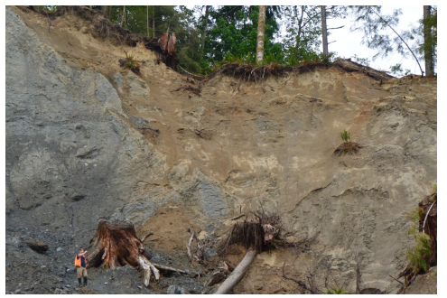
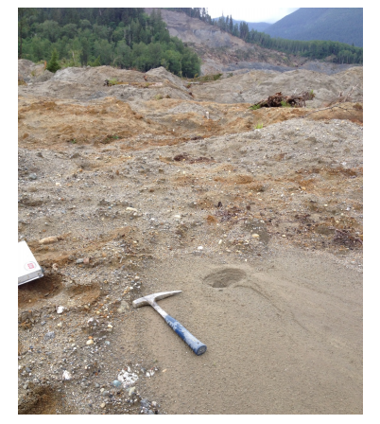
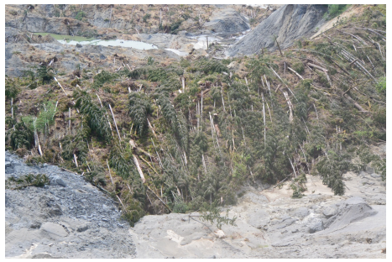
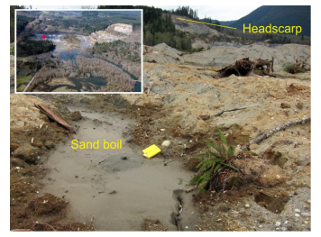

Slide 9
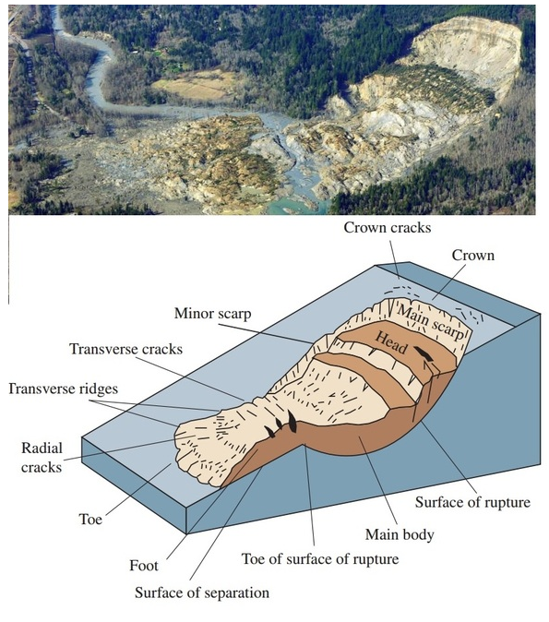
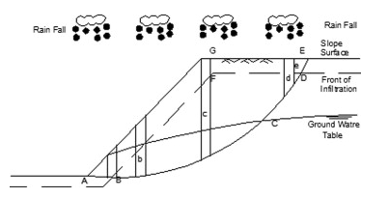
Slope Analysis
http://ososlide.weebly.com/
Notes:
It is almost too clear that the highest and most dramatic scarp at the top of the slide area moved first due to an almost vertical separation from Whitman Bench (portion A in the analysis above) caused by high pore pressure in the sand zone within the whole bench section. The USGS web site on landslides (http://pubs.usgs.gov/fs/2004/3072/fs-2004-3072.html) outlines the model shown just above which clearly matches the topography and mechanism of the Oso slide.
'Saturation of a soil will decrease the frictional shear strength. This is due to the buoyant reduction in normal force required for frictional shear strength by the pore pressure (the effective stress principle). Saturation of soil may also destroy capillarity and “apparent cohesion” on the cohesive component of the soil, or may reduce the dry strength of a cohesive soil.' Quoted from:
Comparison study between traditional and finite element methods for slopes under heavy rainfall by M. Rabie NBRC Journal, Volume 10, Issue 2, August 2014, Pages 160–168
This article describes two methods of modelling the common occurrence of rotational slide masses like that of the Hazel upper block during periods of heavy rain. They also point out various mechanisms of excess rainfall in inducing slides:
'In this paper, the main work focuses on two types of infiltration pattern (saturated and unsaturated), the two types of failure modes (shallow and deep-seated failure) and the four ways of affecting slope stability in the rainfall (the decrease of soil shear strength, the increase of bulk density, the increase of pore pressure and the action of seepage force)

Slide 10
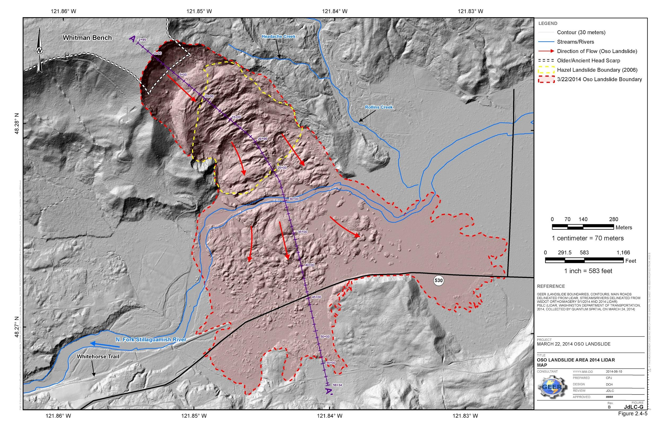
GIS and LIDAR Analysis
http://ososlide.weebly.com/
Notes:
Benefited greatly from the availability of pre-event (2013) and post-event (2014) lidar topography as well as orthorectified aerial photography supplied by Snohomish County and the State of Washington. Additional lidar data acquired in 2003 aided our understanding of the 2006 Hazel landslide. The most useful product from each set of lidar data is a digital elevation model (DEM), which provides elevations at regularly gridded points with 0.91 m horizontal resolution.
Used to derive the volume of the landslide and provide helpful ‘answers’ to the interpretive models that are used to analyze the event.

Slide 11
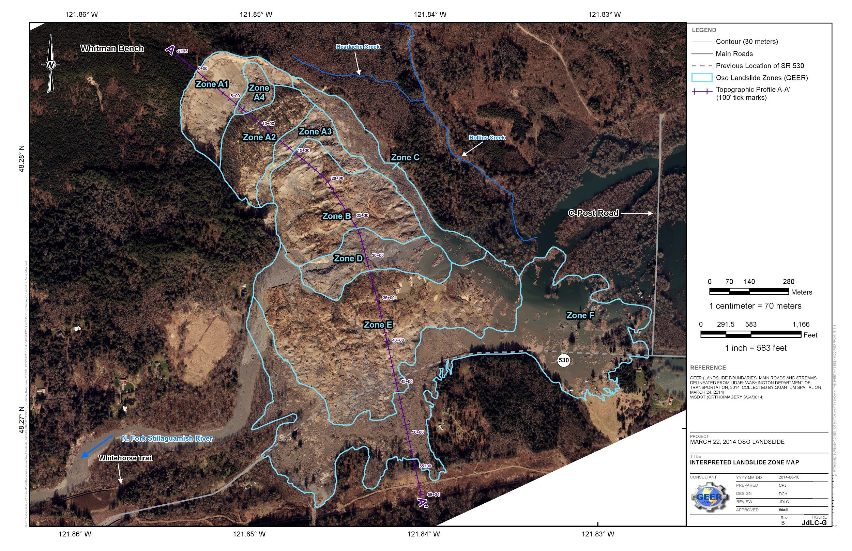
GIS and LIDAR Analysis
http://ososlide.weebly.com/

Slide 12
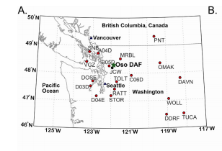
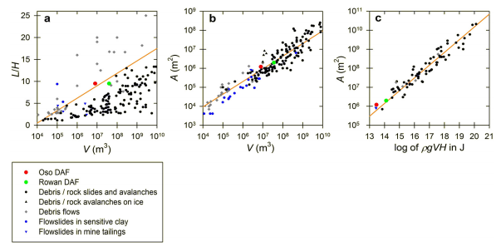
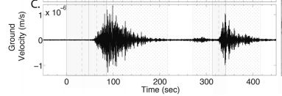
Seismology Analysis
Landslide mobility and hazards: implications of the 2014 Oso disaster
Notes:
Use of seismic data to assess the behavior of landslides requires methodology that differs from that used to study tectonic earthquakes (Kanamori and Given, 1982; Allstadt, 2013; Ekström and Stark, 2013). Ground-shaking velocities containing many superposed frequencies can obscure the essential features of landslide dynamics. When observed using only far-field, long-period data, however, a landslide radiates seismicity equivalent to that of a single force pointing in the opposite direction of the acceleration of the landslide center of mass, with a magnitude equal to the acceleration times the mass (Kanamori and Given, 1982). Using methods detailed by Allstadt (2013), we inverted the long-period (T = 30–60 s) seismic data from 18 broadband seismic stations located 19 to 341 km from the Oso DAF site to obtain a time series of forces exerted on the earth by the moving landslide (Fig. 3A). The inversion model fits the data well, explaining 74% of the data variance (Fig. 3B), and this inversion is crucial for our interpretation of landslide chronology.
However, high-speed motion of the disaggregating DAF ensued, and appears to have lasted about 100 s based on the duration of high-frequency
They used an eye-witness to verify with their estimates

Slide 13
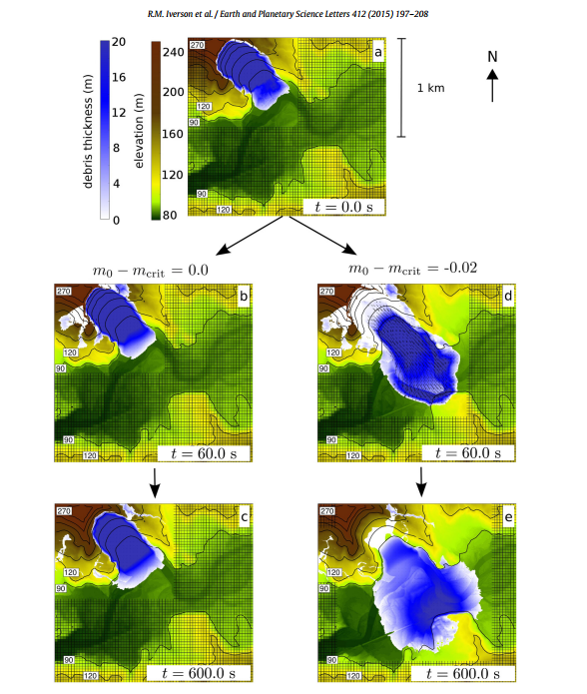
Numerical Analysis
Computer simulation performed by USGS demonstrating the variability of outcome based on porosity and water saturation.
https://www.youtube.com/watch?v=Gj-7AyVwqZ0
Landslide mobility and hazards: implications of the 2014 Oso disaster
Link to paper on D-Claw-
http://rspa.royalsocietypublishing.org/content/470/2170/20130820.full.pdf+html
Notes:
A novel feature of D-Claw is its ability to seamlessly simulate landsliding during both the onset of slope failure and subsequent landslide runout. The model employs a shock-capturing finite-volume method and adaptive mesh refinement (AMR) to solve a hyperbolic system of five depth-integrated partial differential equations derived by combining continuum conservation laws with concepts from soil mechanics, fluid mechanics, and grain– fluid mixture mechanics (Iverson and George, 2014; George and Iverson, 2014). In addition to computing evolving values of two components of landslide velocity and the landslide thickness, DClaw computes the coevolution of the solid volume fraction m and basal pore-fluid pressure. Evolving basal pore pressure influences landslide mobility though application of the Coulomb friction rule and effective-stress principle, which are widely used in landslide and debris-flow mechanics (Iverson, 1997; Iverson et al., 1997; R.M. Iverson et al., 2010).
Initial conditions consist of the initial landslide volume and geometry inferred from differencing these DEMs, as well as initial values of two material properties (bulk compressibility and hydraulic permeability) that evolve in response to evolution of the solid volume fraction
Used to see varying differences - D-Claw is the first model to incorporate liquefaction flow into slope failure analysis
where m0 is the initial solid volume fraction and mcrit is the static, critical-state solid volume fraction
. Finally, high pore pressures may dissipate slowly in rapidly moving, water-laden landslides that contain even small amounts of silt and clay, and the moving sediment–water mixtures consequently can remain highly mobile

Slide 14
References
George, David L., and Richard M. Iverson. "A depth-averaged debris-flow model that includes the effects of evolving dilatancy. II. Numerical predictions and experimental tests." Proceedings of the Royal Society A: Mathematical, Physical and Engineering Science 470.2170 (2014): 20130820.
Iverson, Richard M., et al. "Landslide mobility and hazards: implications of the 2014 Oso disaster." Earth and Planetary Science Letters 412 (2015): 197-208.
Miller, Daniel J., and Joan Sias. "Deciphering large landslides: linking hydrological, groundwater and slope stability models through GIS." Hydrological Processes 12.6 (1998): 923-941.

